Slide 1

Students Mark Data Analysis
Initial Project Submission – Review 1
Semester - 4
Neha kumari (Admin)
23scse1010494
Devendra Kumar(Member)
23scse1010864

Slide 2

Project Overview
This project involves analyzing a dataset using data preprocessing and exploratory data analysis (EDA) techniques. The aim is to clean, transform, and visualize the data to identify patterns and insights.
In Review 1, we focus on:
Handling missing values
Data transformation and cleaning
Basic feature selection
Visual exploration of data

Slide 3
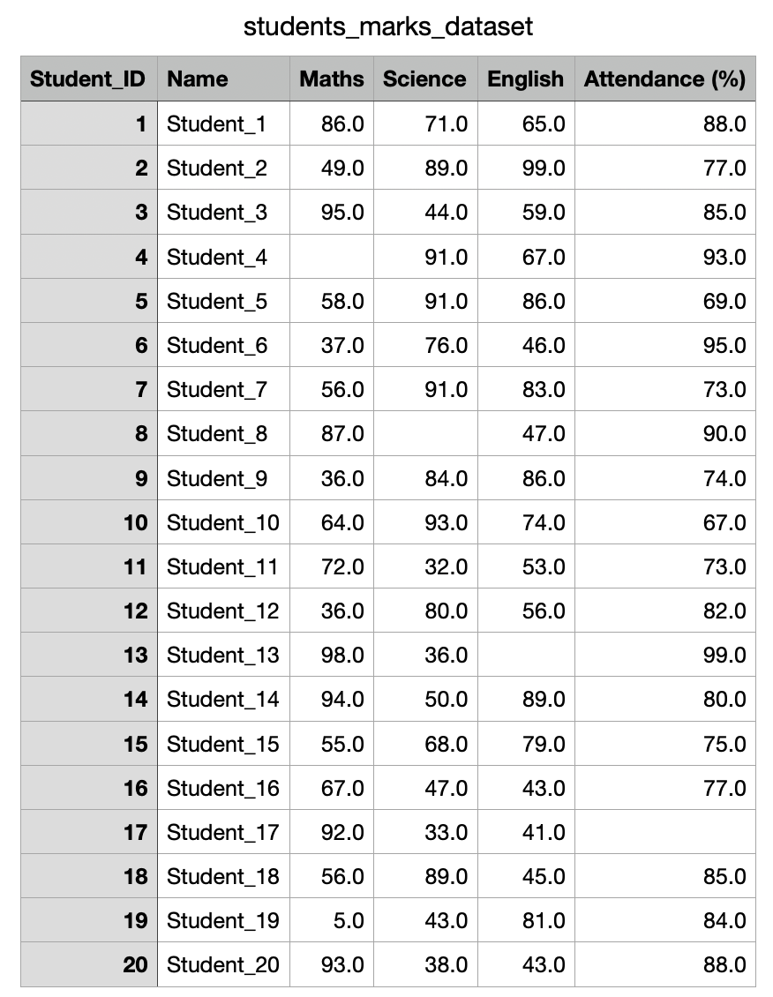
Dataset name : Students marks and attendance
Number of Rows: 20
Number of Columns: 6
Description:
This dataset contains academic performance and attendance records of 20 students. Each record includes a unique Student ID, student name, and scores in three subjects: Maths, Science, and English. It also includes the attendance percentage of each student. The dataset will be used to analyze performance patterns and identify factors influencing academic success.

Slide 4
Data preprocessing steps:
1. Checked for missing values using isnull() and sum()
2. Filled missing values using:
- Mean for numerical data
- Mode for categorical data
3. Removed duplicate records
4. Handled outliers using IQR/Z-Score method
5. Converted categorical data into numerical format using Label Encoding

Slide 5
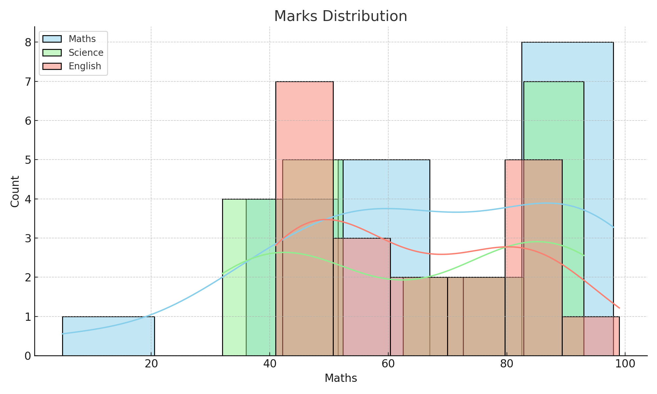
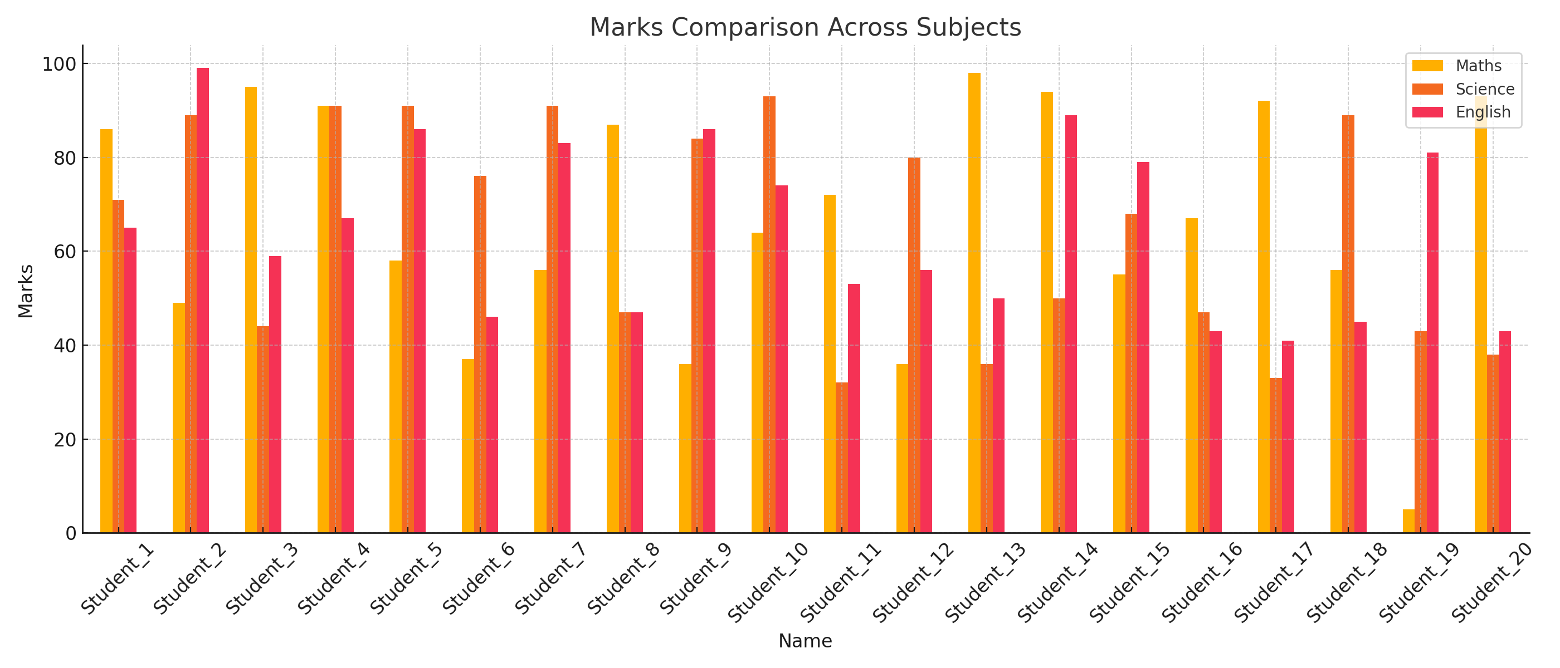
Exploratory Data Analysis (EDA)
Performed basic statistical analysis: • mean(), median(), mode(), describe() • value_counts() for attendance ranges
Visualized data distributions and relationships using: • Histogram of Maths scores • Box Plot of English scores • Bar chart for Attendance ranges • Correlation Heatmap of all numeric features

Slide 6
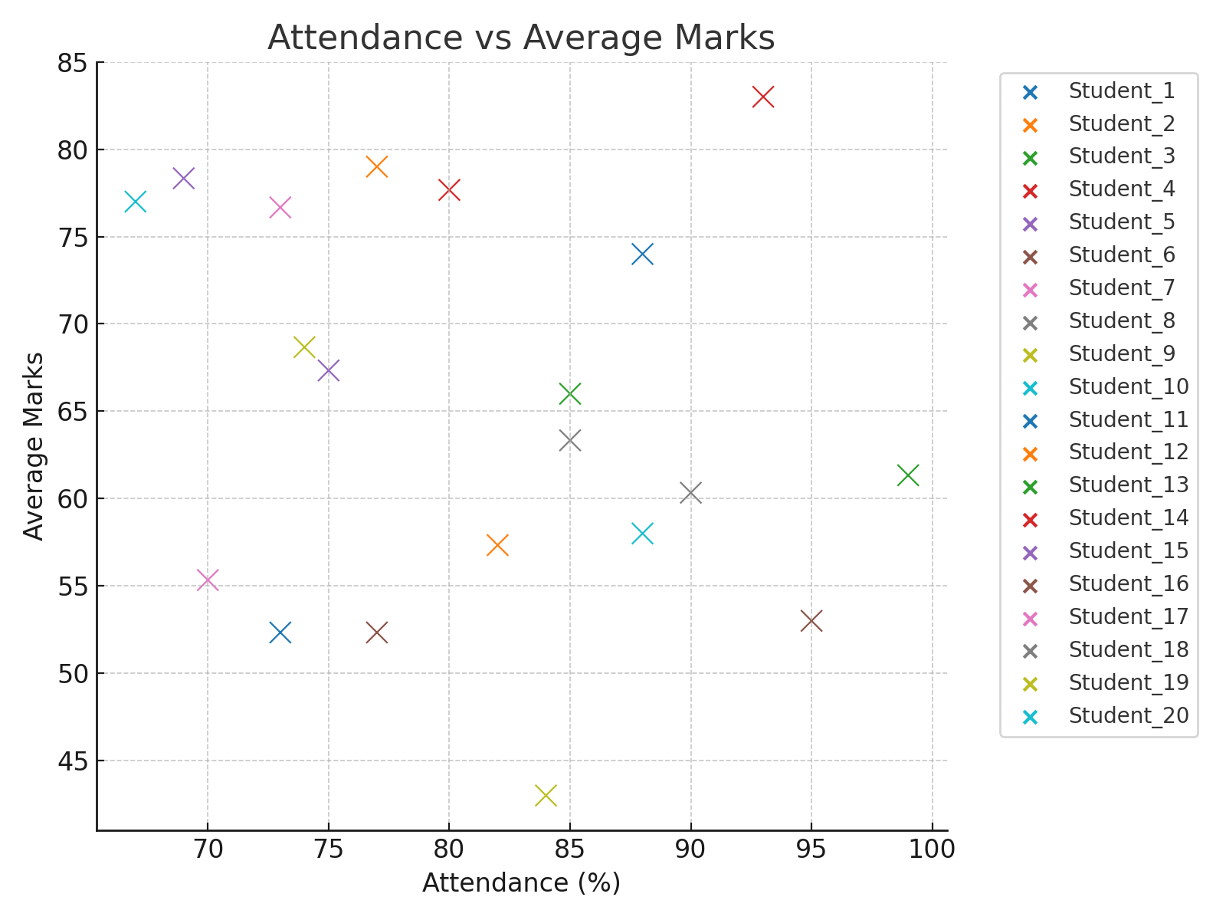
Key Observations
Maths scores are mostly concentrated between 50 and 90, with some students scoring below 40 or above 90.
Outliers detected in English scores — especially low scores (e.g., 41, 43).
Strong positive correlation observed between Maths and Science scores.
No major class imbalance, as this is a regression-style dataset, but Attendance varies widely — with most students scoring between 70% and 90%.

Slide 7
Tools and Libraries Used:
Python
• Pandas
• NumPy
• Matplotlib
• Seaborn

Slide 8
Code ( in python):
# 3. Handling Outliers (Z-score)
from scipy.stats import zscore
z_scores = np.abs(zscore(df[num_cols]))
df = df[(z_scores < 3).all(axis=1)]
# 4. Feature Selection (Remove low variance features)
selector = VarianceThreshold(threshold=0.01)
df_selected = pd.DataFrame(selector.fit_transform(df[num_cols]), columns=num_cols[selector.get_support()])
# 5. Data Transformation (Standardization)
scaler = StandardScaler()
df_scaled = pd.DataFrame(scaler.fit_transform(df_selected), columns=df_selected.columns)
# 6. Summary Statistics
print("Summary Statistics:\n", df_scaled.describe())
# 7. Visualization
sns.heatmap(df_scaled.corr(), annot=True, fmt=".2f")
plt.title('Correlation Heatmap')
plt.show()
# Pairplot for selected features
sns.pairplot(df_scaled.iloc[:, :4]) # Only first 4 for readability
plt.suptitle('Pairplot of Features', y=1.02)
plt.show()
# Distribution of target (if available)
# sns.countplot(x='TargetColumn', data=df) # Uncomment and replace
# data_preprocessing_project.py
import pandas as pd
import numpy as np
import seaborn as sns
import matplotlib.pyplot as plt
from sklearn.impute import SimpleImputer
from sklearn.preprocessing import StandardScaler
from sklearn.feature_selection import VarianceThreshold
# Load dataset (use your dataset or an example like Titanic)
df = pd.read_csv(r'C:\Users\HP\OneDrive\Desktop\students_marks_dataset.csv') # Replace with your actual CSV file
# 1. Initial Exploration
print("Dataset shape:", df.shape)
print(df.info())
print(df.describe())
# 2. Handling Missing Values
missing_values = df.isnull().sum()
print("Missing values:\n", missing_values)
# Impute numerical values with median
num_cols = df.select_dtypes(include=['int64', 'float64']).columns
imputer = SimpleImputer(strategy='median')
df[num_cols] = imputer.fit_transform(df[num_cols])
# Impute categorical with most frequent
cat_cols = df.select_dtypes(include=['object']).columns
imputer_cat = SimpleImputer(strategy='most_frequent')
df[cat_cols] = imputer_cat.fit_transform(df[cat_cols])

Slide 9
Output of the code :

Slide 10
Conclusion :
In this phase of the project, we prepared the dataset by handling missing values, cleaning data, and applying EDA techniques to gain initial insights.
This sets the foundation for the next phase: applying machine learning models and evaluating their performance.
Github link(Repository ):
https://github.com/nehaaa789/data-analytics-

